Slide 1
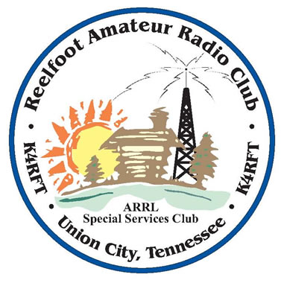
RF Receiver Architecture
- Past, Present, and Future
Jamie Hall WB4YDL

Slide 2
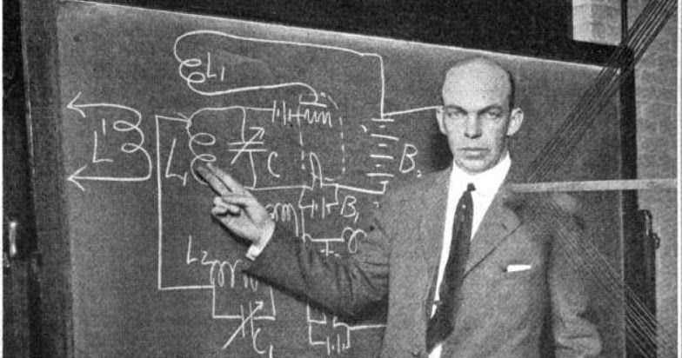
Receiver History – Part 2
Edwin H. Armstrong
Notes:
We’ll start with EH Armstrong whose brilliance will become evident – here standing at the blackboard with the schematic of the regenerative receiver.

Slide 3
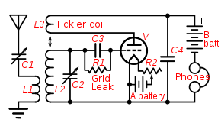
Regenerative Receiver
Uses positive feedback
Increases gain but also the Q factor of the tuned circuit
This decreases bandwidth which increases selectivity
Made to oscillate for CW
A single tube acted as both BFO and detector
“Autodyne”
Notes:
Some of the energy of the output is fed back to the input, causing increased gain. Positive feedback is putting some of A back into B, which gives you more of A, which gives you more B, etc. Can easily break into self-oscillation. It takes advantage of the inherent loss in the LC circuit and gives part of this loss back. The “A voltage” is filament voltage, the “B voltage” is plate voltage.

Slide 4
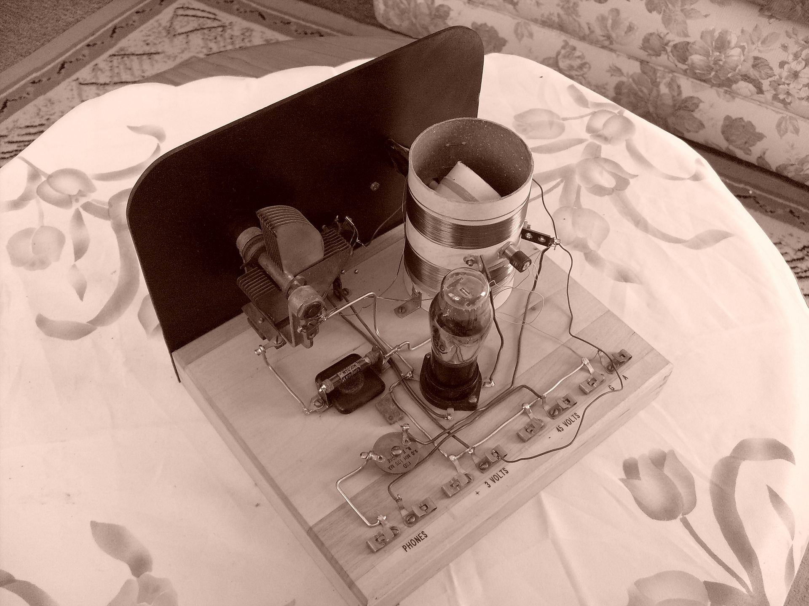
Regenerative Receiver
Armstrong circuit – “Tickler” coil - variometer
Notes:
An example of a regenerative receiver with its tickler coil. The A voltage is 3 volts, and B voltage is 45 volts. The regenerative portion of the circuit compensates for the resistive losses of the tuned LC circuit. If you feed back more than the resistive losses, then oscillation occurs. Oscillation can also be transmitted out and cause RFI.

Slide 5
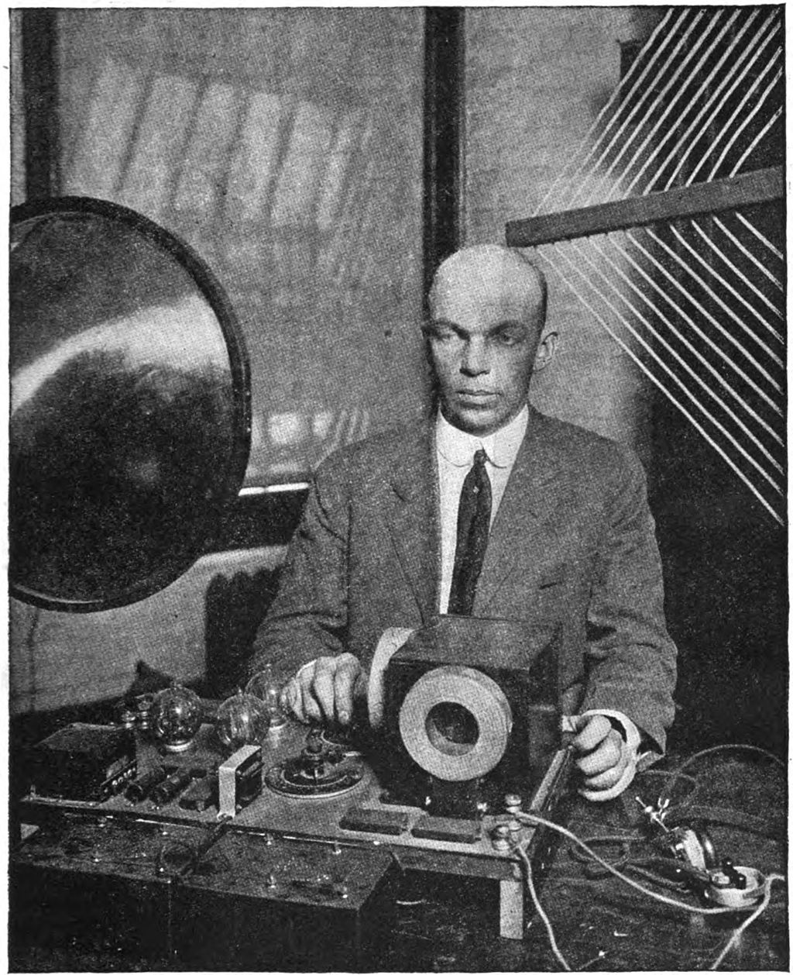
Regenerative Receiver
Notes:
This is actually a super-regenerative receiver which adds another stage of oscillation – note the multiple tubes. This architecture is still used in such things as garage door openers and walkie-talkies, only without the tubes !

Slide 6
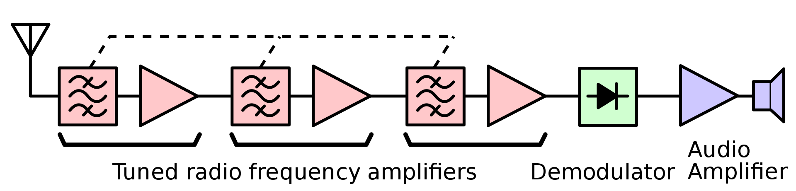
Tuned RF (TRF) Receiver
Several tuned RF stages
Amplified enough to drive a detector
Did not radiate interference
Complicated to tune multiple RF stages
Notes:
Invented by Ernst Alexanderson. All the RF stages had to be tuned to the same RF frequency. Then sent to a detector (demodulator) where audio is detected and sent to an audio amplifier to drive a speaker. In early days of radio, receivers had to be sensitive enough to hear ANY signal. Later, as more signals were on the air, receivers had to be more selective to select one, and only one, signal. Selectivity requires a narrow bandwidth.

Slide 7
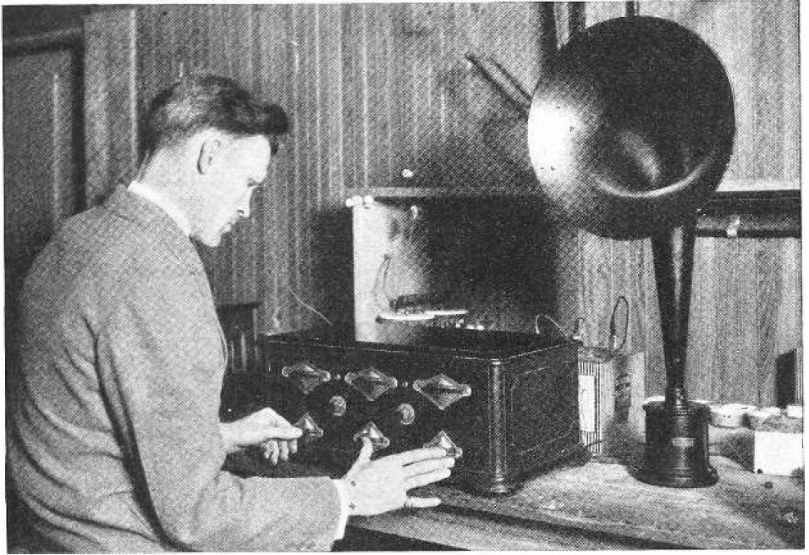
Tuned RF (TRF) Receiver
Notes:
Note that all RF stages of the TRF receiver had to be tuned carefully and simultaneously. Ganged capacitors were tried but they would not track the same from stage to stage.

Slide 8
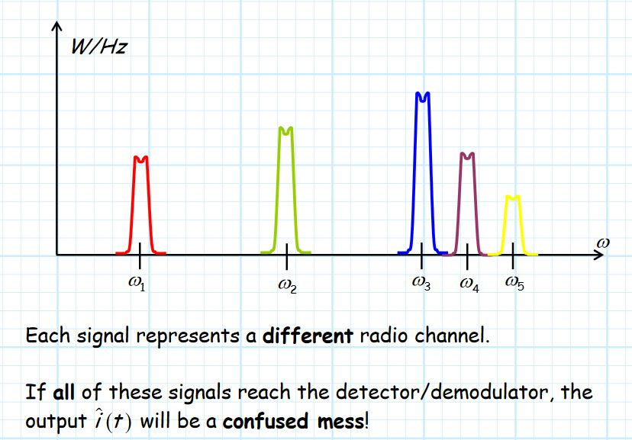
Tuned RF (TRF) Receiver
Notes:
It’s the job of the receiver to select one signal, amplify it, and present that ONE signal to the detector (demodulator). Therefore, the receiver must suppress all other signals that come out of the antenna.

Slide 9
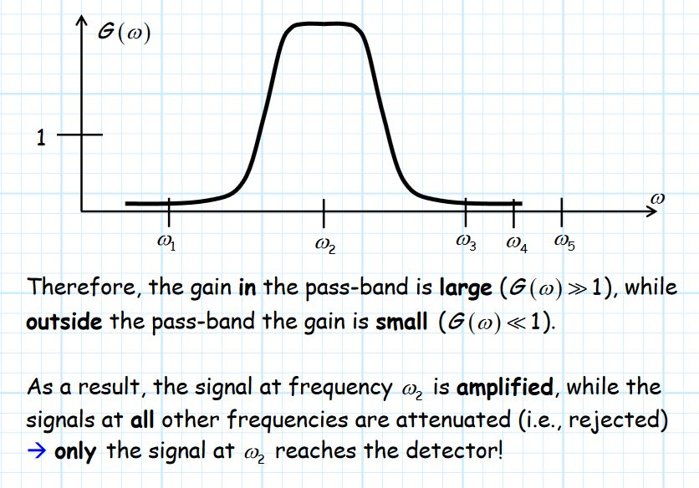
Tuned RF (TRF) Receiver
Notes:
When tuning the RF stages, you’re tuning the passband which has a large amount of gain.

Slide 10
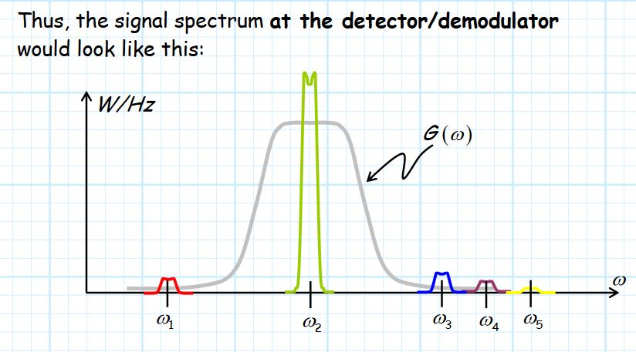
Tuned RF (TRF) Receiver
Notes:
The desired signal is amplified and the other signals are suppressed.

Slide 11
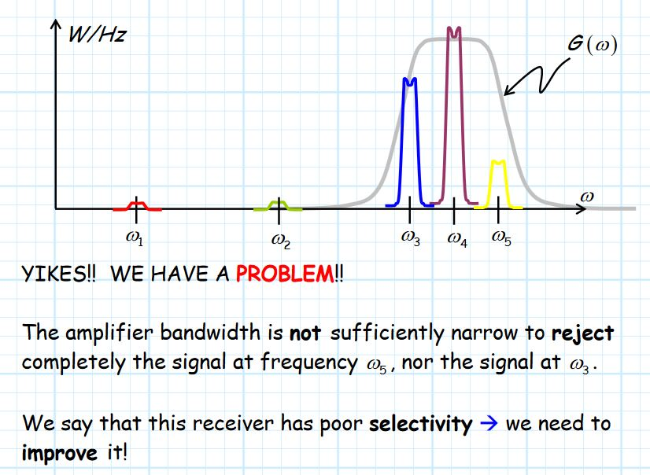
Tuned RF (TRF) Receiver
Notes:
Now, say we want to tune the signal at omega 4. We can improve selectivity by adding tunable, narrow, band-pass filters.

Slide 12
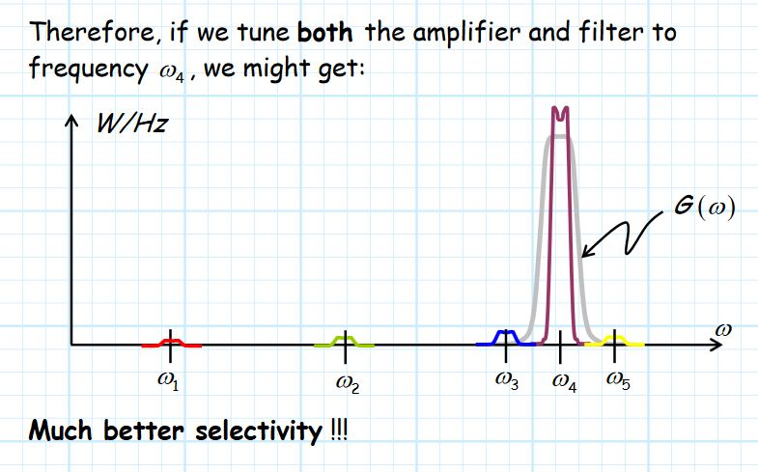
Tuned RF (TRF) Receiver
Notes:
Note the selectivity (ie. Bandwidth) of the receiver should be just wide enough to allow the entire signal bandwidth to pass undistorted to the detector. Also, the roll-off of the filter must be steep enough to sufficiently attenuate radio signals on adjacent channels.

Slide 13
Basic Receiver Design Principles
Selectivity is a desirable receiver characteristic
Requires a narrow bandwidth
Governed by a tuned circuit in the RF amplifier stage
Limited by the Quality Factor (Q) of the tank circuit
  Q = inductive reactance (X_{L}) of the tank coil
  coil resistance (R)
  is a constant for that circuit
Receiver bandwidth (BW) changes with frequency of LC circuit as
  BW = resonant frequency / Q
Very Important !!
  As the resonant frequency of the tank (LC) circuit changes, so must the bandwidth

Slide 14
Basic Receiver Design Principles
Examples :
  Circuit design Q = 55
  At 550 kHz, the received BW is
  BW = 550 kHz = 10 kHz (satisfactory)
  55
  At 1650 kHz, the received BW is
  BW = 1650 kHz = 30 kHz (lousy)
  55
Major reason broadcast band was low in frequency and “shortwave” frequencies were not used

Slide 15


Basic Receiver Design Principles
Transformers
Converts AC at one voltage to the same waveform at another voltage
The power input and output are the same
The side with lower voltage is at low impedance because it has the lower number of turns. Visa versa – side with higher voltage has higher impedance due to a higher number of turns
Example : TV transformer
  300 Ω twinlead (balanced) to 75 Ω RG-6 coax (unbalanced)
  Turns ratio = source resistance = 300 Ω = 2 : 1 balun
  load resistance 75 Ω
$$√$$
$$√$$

Slide 16
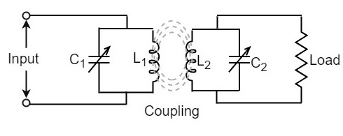
Basic Receiver Design Principles
Double-tuned inductively-coupled circuit
Resonant transformer (RF transformer)
At resonance, the impedance is matched allowing signal at that frequency to easily pass
Acts as a bandpass filter which shunts out-of-resonant signals to ground
Can adjust mutual inductance by adjusting coupling – distance between coils or angle (eg. Tickler)
Notes:
The first RF section of a receiver has the antenna as the capacitor connected to the input coil of the transformer and then to ground. The load would be the rest of the circuit such as the detector.

Slide 17
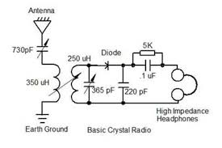
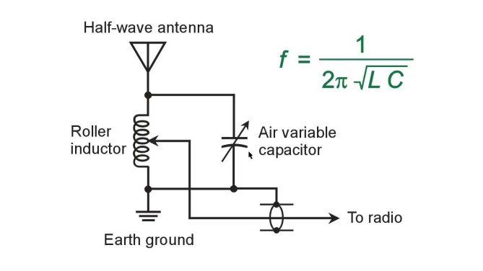
Basic Receiver Design Principle
First RF transformer
Tuning for the received station by adjusting tuning capacitor (and/or coil coupling)
Similar to antenna tuner
Tuning to match impedance to allow signals to pass easily to radio

Slide 18
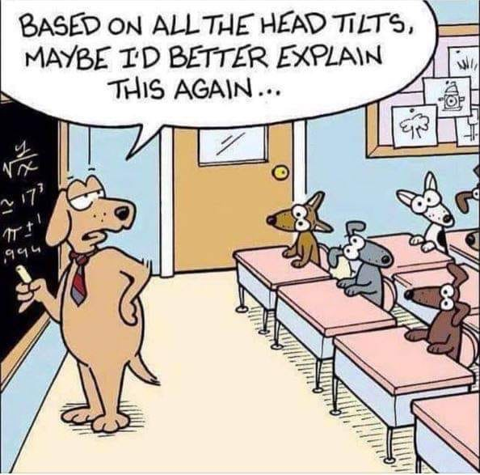
Basic Receiver Design Principle

Slide 19
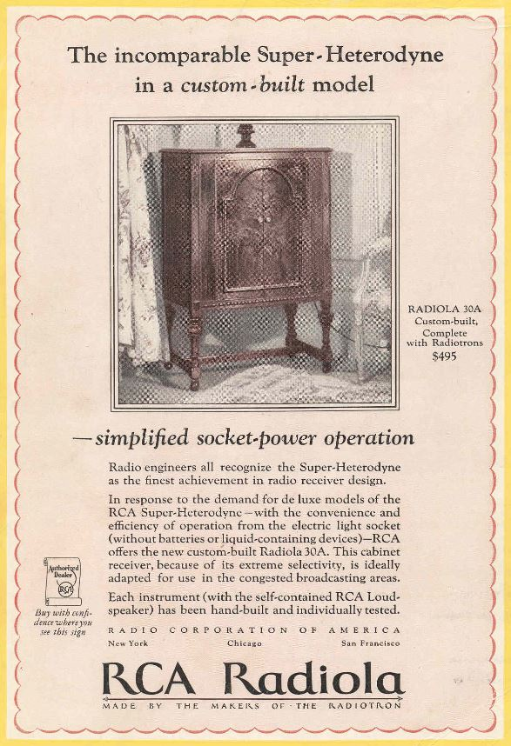
Superheterodyne Receiver
Notes:
The answer to the BW – frequency problem was the development of the superheterodyne receiver invented by Edwin Armstrong.

Slide 20
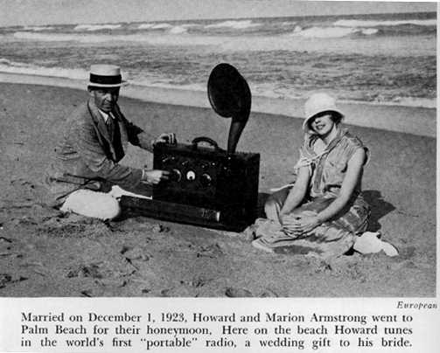
Superheterodyne Receiver

Slide 21
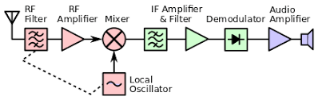
Superheterodyne Receiver
Innovation is the development of the Local Oscillator (LO)
The LO will vary in frequency with the received RF carrier frequency
  Implemented using ganged capacitor tuning
Both the RF and the LO signals are presented to a mixer stage. Produces two signals –
  Difference (RF – LO) = (usually) 455 kHz
  Sum (RF + LO) = easily filtered with a low pass filter (LPF)
Resultant 455 kHz is called the intermediate frequency (IF) and is FIXED
Notes:
Developed by Edwin Armstrong. Supersedes regenerative approach with its positive feedback and tendency to self-oscillate.

Slide 22
Superheterodyne Receiver
The genius is that ALL subsequent amplification, filtering, and demodulation can be designed and optimized for this ONE frequency
The IF signal is then sent to a detector (demodulator) where the low audio frequencies (baseband) results
Audio is then sent to an audio amplifier which drives a speaker
Can be used with any type of modulation
The LO originally implemented by a tube, then transistors, then IC’s. Now analog LO’s have largely been replaced by digital frequency synthesizers. These use a crystal whose frequency is digitally manipulated.
Notes:
This has been the tried and true approach and “last word” in receiver architecture for 100 years … until recently.

Slide 23
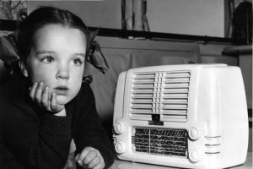
Superheterodyne Receiver
The All American Five (AA5)
Five tube superhet receiver that had no transformer for B+
Heater voltage of the 5 tubes were in series and added to 121VAC
Very popular in the 1940-50’s

Slide 24
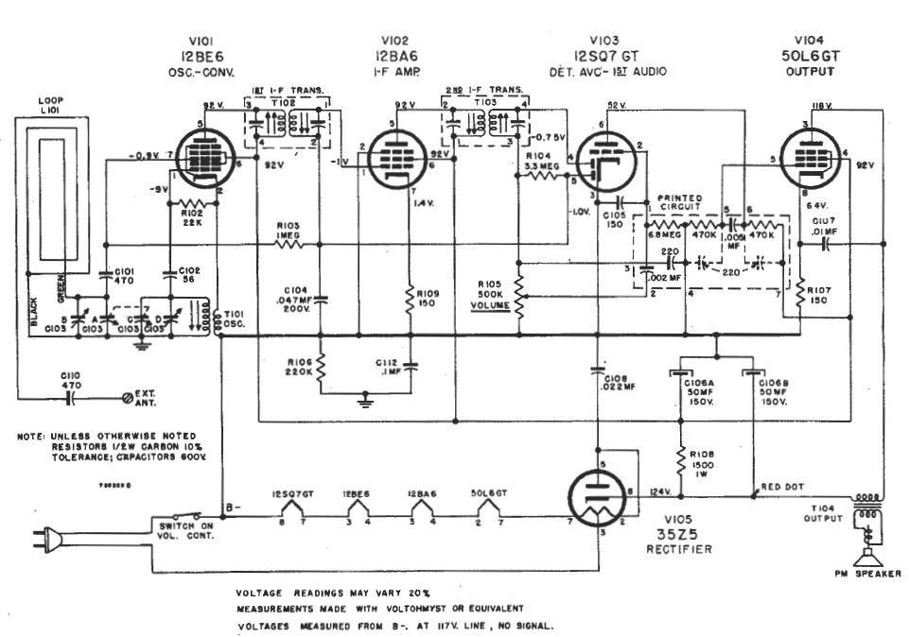
Superheterodyne Receiver

Slide 25
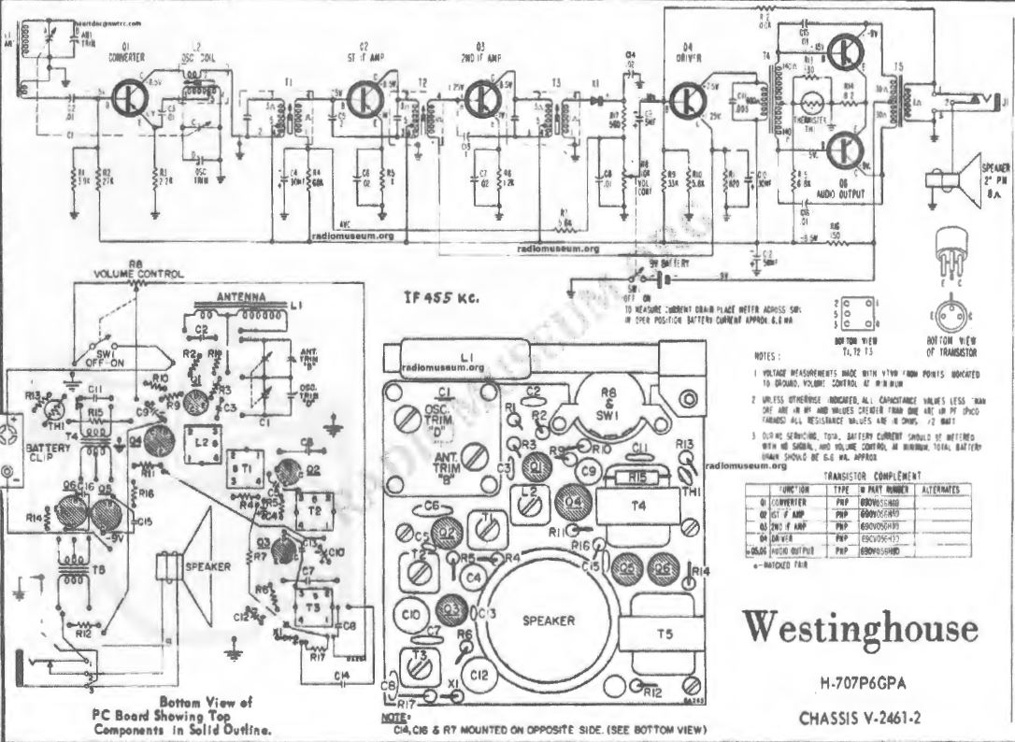
Superheterodyne Receiver
Notes:
Eventually, tubes gave way to transistors, and miniaturization took off. This is a common transistor radio with all PNP transistors c. 1960’s. AM broadcast only with 455 khz (KC) IF.

Slide 26

Superheterodyne Receiver
Notes:
Never could find a radio with batteries like that !

Slide 27
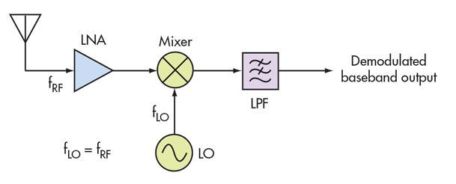
Direct Conversion Receiver
A simpler design in an effort to simplify the circuit complexity of the superheterodyne receiver
Basic Principles
  RF carrier frequency and LO frequency are the same or nearly so
  Mixer produces baseband directly without IF conversion
Notes:
Also known as the “Homodyne” receiver

Slide 28
Direct Conversion Receiver
Advantages
  Decreased circuit complexity which translates to decreased noise
  No image frequencies are produced -> no “birdies”
  Good for CW as the LO works as a BFO
    A RF-LO difference of 750 Hz would give a nice CW tone
  Can “zero beat” (RF=LO) for suppressing AM carrier and select upper or lower sideband
Disadvantages
  Places extreme demand on both LO and mixer performance
    Any instabilities degrade performance
  Wandering LO problem – out of focus, blurry sine wave
    Led to development of the phase lock loop (PLL)
Newer advances in semiconductor development have made DCR practical in some applications
  Examples : Hold your cell phone up !
    Actually 4 transceivers – cell, GPS, Wi-fi, and Bluetooth
    Also medical imaging such as magnetic resonance (MRI)

Slide 29
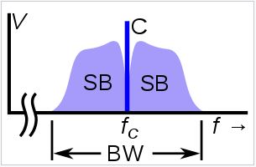
Direct Conversion Receiver
When the RF and LO frequencies are equal, the scheme works as a phase detector
Suppose that the IF in a superhet is reduced to 0 Hz
The LO will translate the center of the channel to 0 Hz (DC)
The portion of the channel translated to the negative frequency half- axis becomes the “image” to the other half of the same channel and would be filtered out
To achieve maximum information, we need both parts of the signal
  How to do this ??

Slide 30
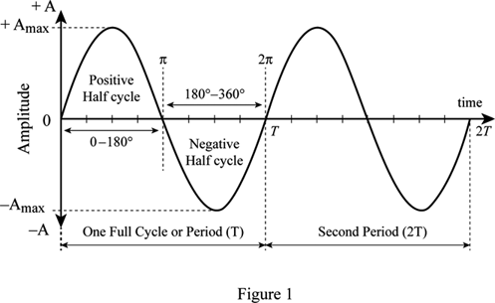


Quadrature Downconversion
Components of a sine wave
V(t) = A * sin (2$πft+ φ)$
A = peak voltage
$f$ = frequency
$t$ = time
$φ$ = phase shift
A
1/$f$
Notes:
Simple amplitude modulation involves changing A over a period of time

Slide 31
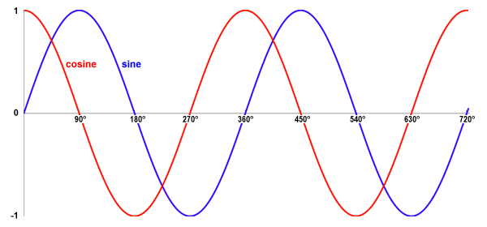
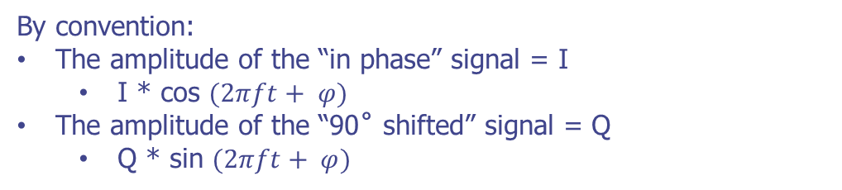
Quadrature Downconversion
Quadrature Signals
Definition : Two signals are said to be in quadrature when they are 90˚ apart in phase (1/4 cycle)
Example : Cosine and Sine waves are in quadrature
I
Q
By convention:
The amplitude of the “in phase” signal = I
  I * cos $(2πft+ φ)$
The amplitude of the “90˚ shifted” signal = Q
  Q * sin $(2πft+ φ)$

Slide 32
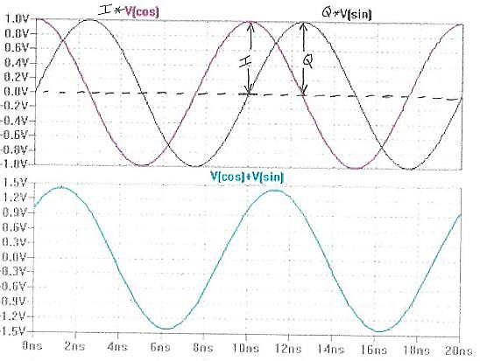
Quadrature Downconversion
Adding Quadrature Signals
I * cos ()
Output
Q * sin ()
When I and Q vary “identically”, the amplitude of the sum varies
When I and Q vary differently, the phase (& amplitude) of the sum varies
Therefore I and Q variations over time result in amplitude and phase modulation of the sum. (Frequency modulation also)
Notes:
Frequency modulation is just a special case of phase modulation. Amplitude changes in I and Q signals which are locked in 90 degree phase difference, will combine to a wave (signal) that varies BOTH in amplitude and phase -> can define any type of modulation. Extreme cases where I or Q = 0.

Slide 33
Quadrature Downconversion
Implications of IQ signal demodulation
= I(t)
Any modulated RF signal can be converted into I(t) and Q(t) signals
0˚
Any RF signal
LO
90˚
= Q(t)
RF signals first divided into 2 identical channels that are fed into 2 separate mixers
LO is mixed in phase to produce I signal (cosine), and mixed 90˚ apart to produce Q signal (sine)
Both I and Q signals are at baseband and are amplitude modulated only
Phase relationship between I and Q signals as well as their amplitudes can define ANY form of modulation – AM, FM, PM, or any combination (ie. QAM – quadrature amplitude modulation). This is the basis of software defined radio (SDR)
Notes:
A simple example would be BPSK (PSK31) in which Q=0. Binary PSK would set the I value to either +1 or -1, or on a circle 0 degrees and 180 degrees. QPSK, quadrature PSK would have 4 values.

Slide 34
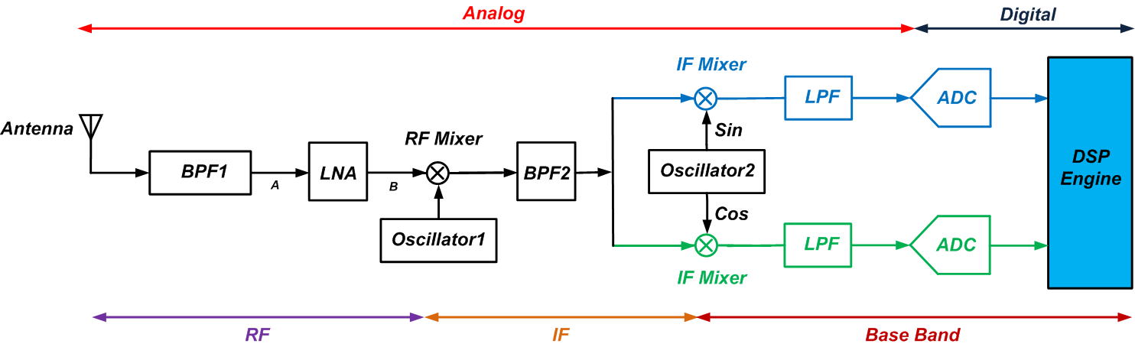
Dual Down-Conversion
Combining heterodyne and homodyne
First heterodyne to an IF frequency
Next direct convert to baseband in quadrature
I and Q signals are sent to analog-to-digital converter
Digital stream sent to digital signal processor
  Performs demodulation and channel decoding
Notes:
Drawbacks to this are 1) the 2 baseband paths must be highly matched, and 2) analog filters introduce phase distortion. There’s a better way !

Slide 35
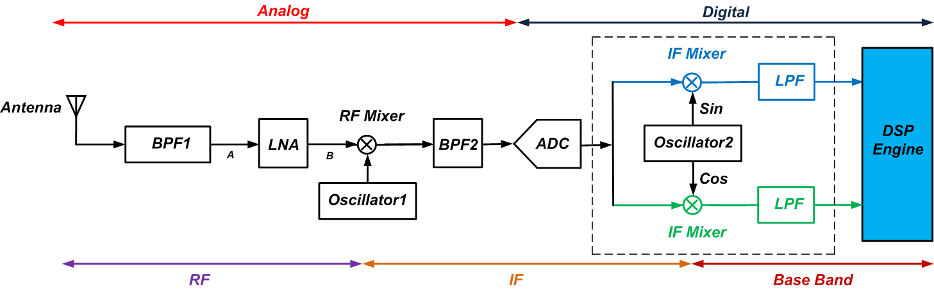
Dual Down-Conversion
A Better Way !
Move the A/D conversion at the IF rather than baseband
Now the 2nd LO is implemented digitally (DDS)
The mixers are digital multipliers and the LPF’s are digital
Imbalance-related distortions from analog components eliminated
The ADC will have to operate at the higher sampling rate, the IF frequency
But what’s an ADC ??

Slide 36
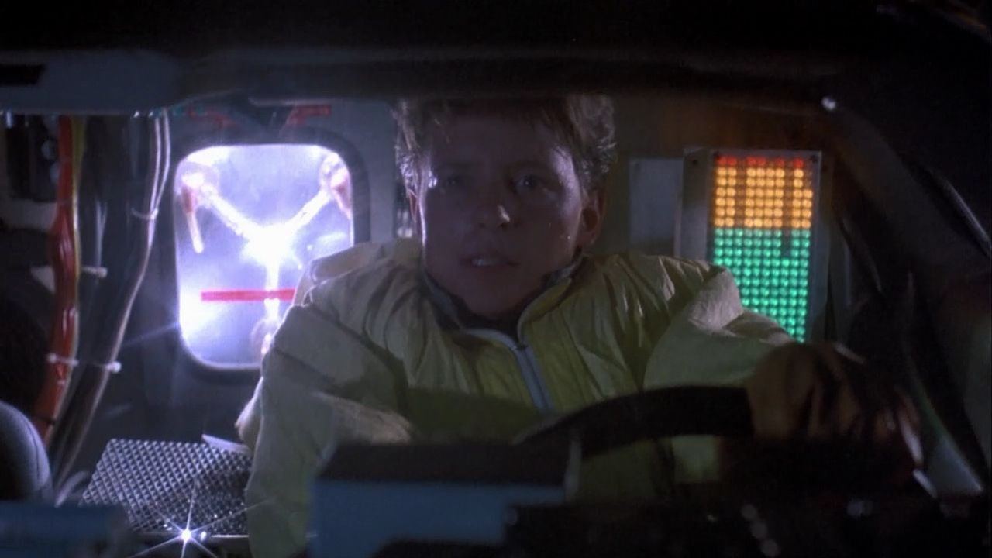
Analog to Digital Converter
Yea, it’s sorta like that !!

Slide 37
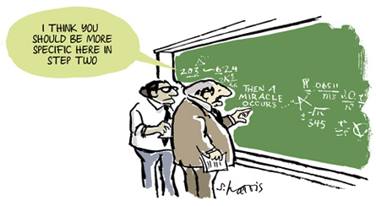
Analog to Digital Converter
I have no intention of describing what actually goes on inside an ADC !

Slide 38
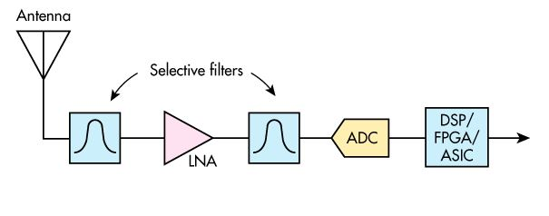
Direct Sampling Receiver
Due to the advent of extremely fast ADC’s, can now sample at RF and even microwave frequencies
Sampling rates must be at least 2X the frequency sampled
  Oversampling maximizes information retention
Remember ! Higher frequency translates to higher bandwidth (BW)
Up until now, we were interested in drilling down to one signal
Now we can translate entire bands of signals simultaneously !
That amounts to a HUGE amount of data being processed
Notes:
RF is first passed through filters to provide some selectivity and then amplified and sent to the ADC. The digital stream is then sent to the FPGA for demodulation, filtering, and channeling. Guess which industry is pushing this advancement in technology ? Hold up your smart phones again !

Slide 39
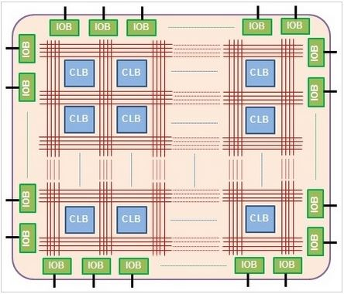
Field Programmable Gate Array
An FPGA is different than a microcontroller
A microcontroller has a CPU; an FPGA does not unless you build one
A processor executes instructions in a sequential fashion and is dependent on software
An FPGA is dependent on firmware (hardware) and runs multiple algorithms in parallel
Very miniscule, highly simplified part of an FPGA
Configurable logic blocks (CLB) – configurable digital subcircuits not just logic gates
Uses a matrix of programmable interconnects to input/output blocks (IOB)
“Programs” are stored in static RAM and details how the hardware should perform
Very important in military and aerospace industries
Notes:
So where does this all lead in the future ?? (Shoe phones ?)

Slide 40
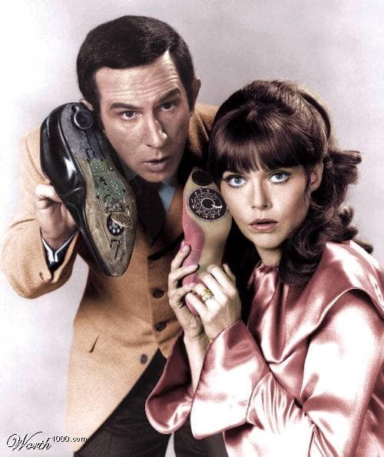
Conclusion – the Future ?
Notes:
Our ears can hear and extract audio information roughly from 20 – 20,000 Hz, or just a couple tens of kilohertz. The information we seek rides upon these so-called carrier waves in the radio spectrum at several 10’s, 100’s and even thousands of megahertz. It’s been quite a ride over the last 100 years to experience how to extract that information, which may have travelled thousands of miles – something that audio can not do no matter how loud you shout ! – to a point where those tiny microvolts of energy can be brought out so you can hear them clearly.

